Slide 1
Word embedding
主讲人：常万里
http://59.80.44.99/web.stanford.edu/class/cs224n/readings/cs224n-2019-notes01-wordvecs1.pdf

Slide 2
Question: How to represent words?
Original method
Count based method
Predict based method

Slide 3
Original method: one-hot

Slide 4
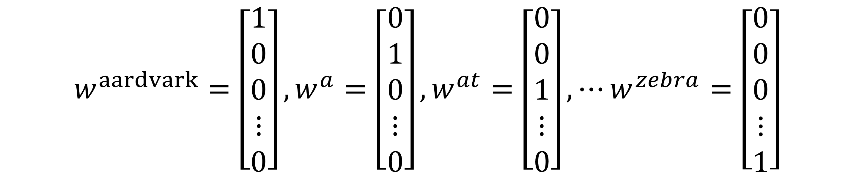
$$w^{aardvark}=\left[\begin{matrix}1 \\ 0 \\ 0 \\ ⋮ \\ 0\end{matrix}\right],w^{a}=\left[\begin{matrix}0 \\ 1 \\ 0 \\ ⋮ \\ 0\end{matrix}\right],w^{at}=\left[\begin{matrix}0 \\ 0 \\ 1 \\ ⋮ \\ 0\end{matrix}\right],⋯w^{zebra}=\left[\begin{matrix}0 \\ 0 \\ 0 \\ ⋮ \\ 1\end{matrix}\right]$$

Slide 5
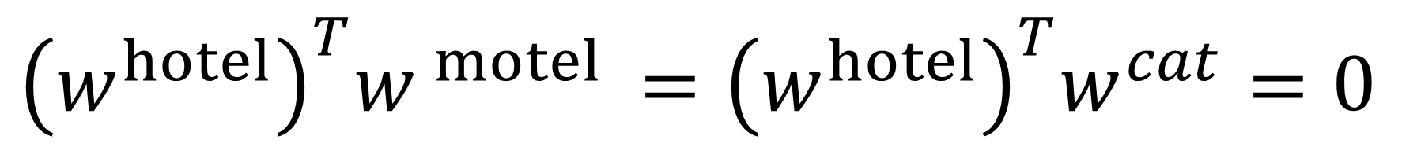
$${\left(w^{hotel}\right)}^{T}w^{ motel }={\left(w^{hotel}\right)}^{T}w^{cat}=0$$

Slide 8
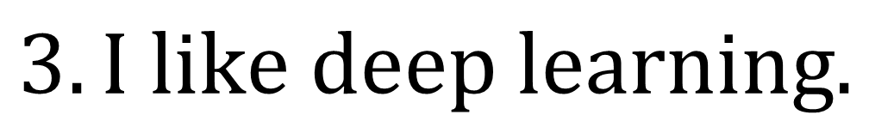
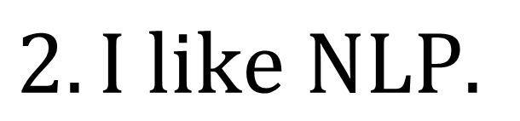
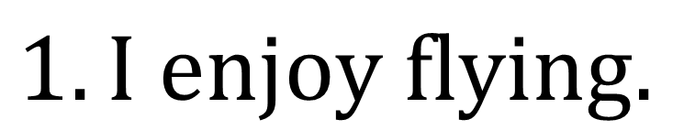
$$Window based Co−occurrence Matrix$$
$$Let our corpus contain just three sentences and the window size be 1$$
$$1. I enjoy flying.$$
$$2. I like NLP.$$
$$3. I like deep learning.$$

Slide 9
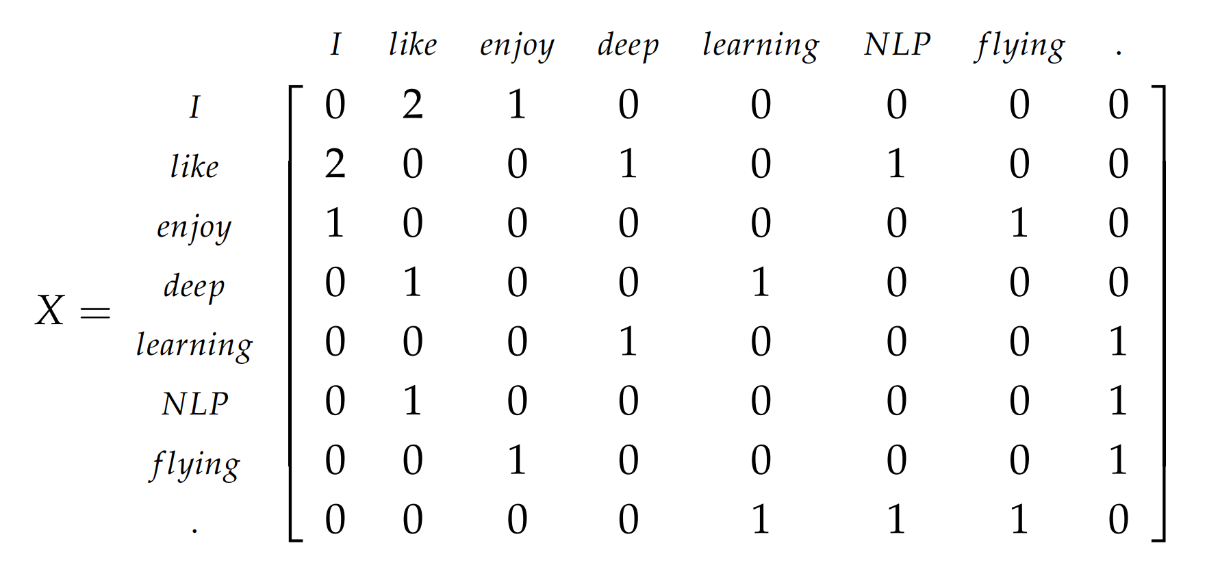
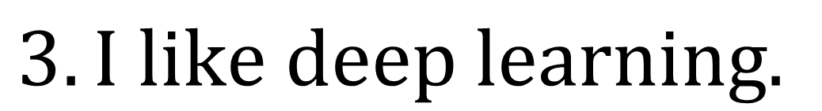
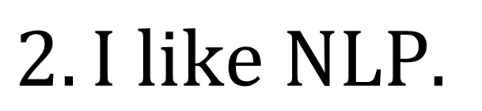
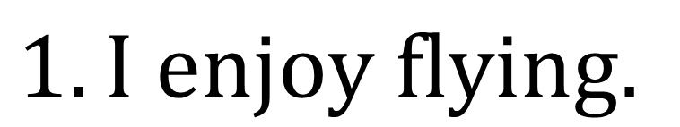
$$\begin{matrix} Step 1. Generate |V|×|V| co−occurrence matrix, X.\end{matrix}$$
$$1. I enjoy flying.$$
$$2. I like NLP.$$
$$3. I like deep learning.$$

Slide 10
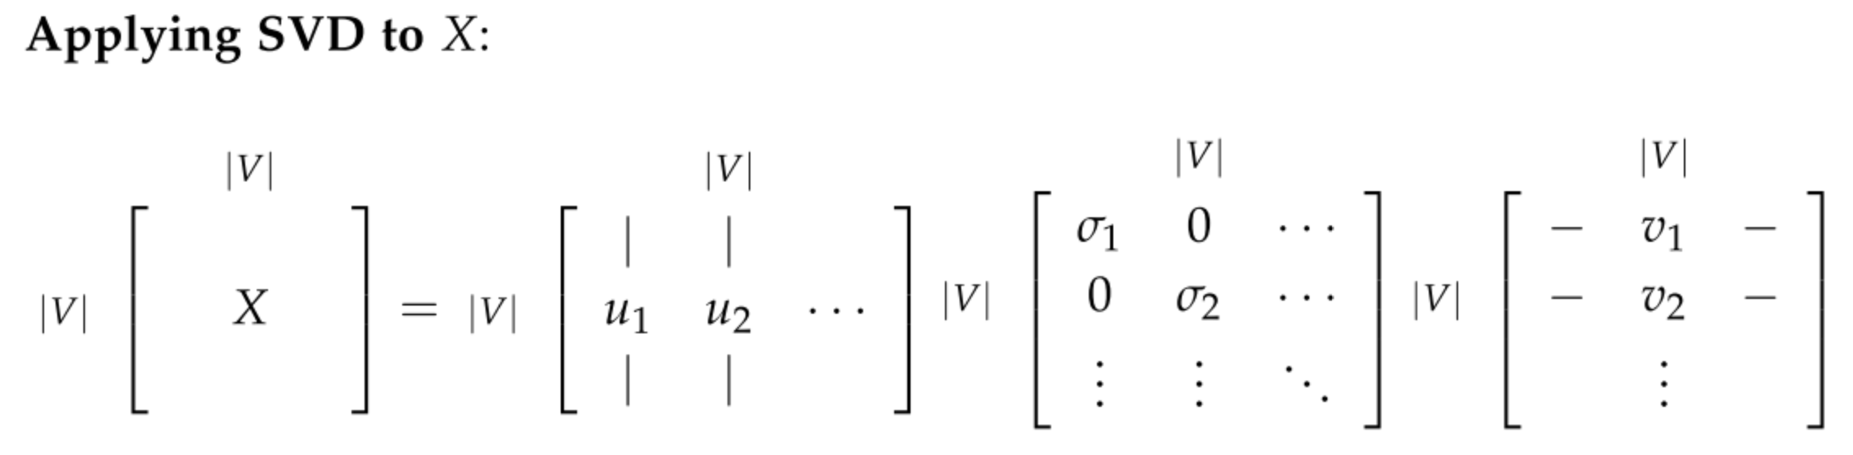
$$Step 2. Apply SVD on X to get X=USV^{T}$$

Slide 11
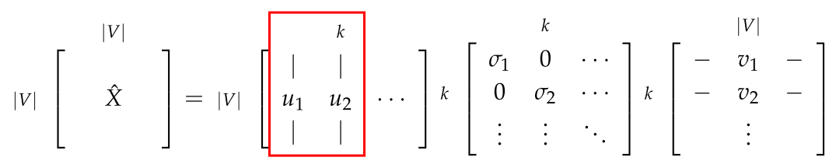
$$Step 3. Reducing dimensionality by selecting first k singular vectors:$$

Slide 13
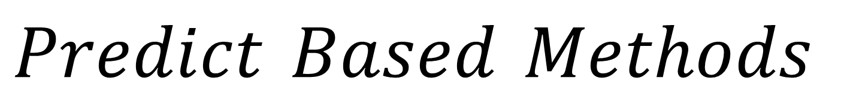
$$Predict Based Methods$$

Slide 14
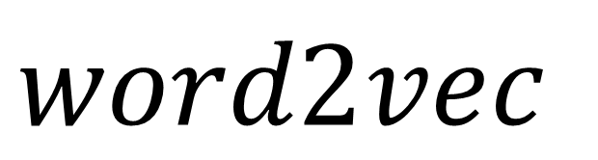
$$word2vec$$

Slide 16
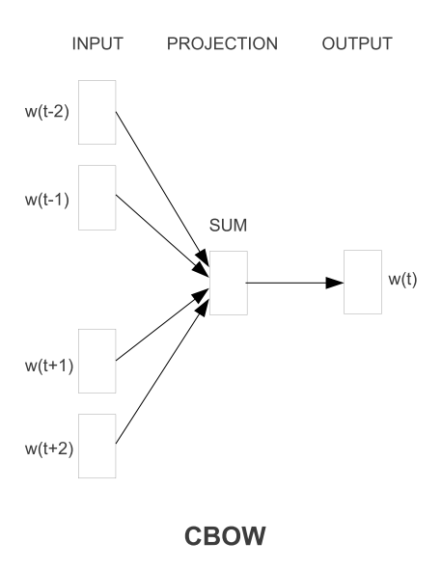
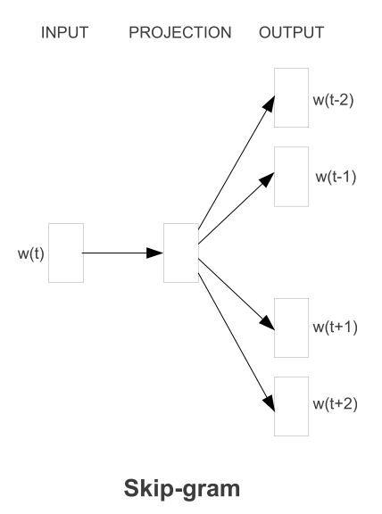
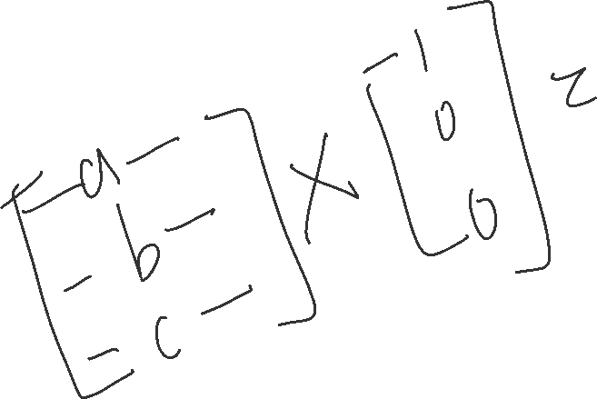
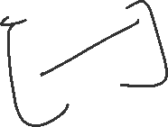

Slide 18
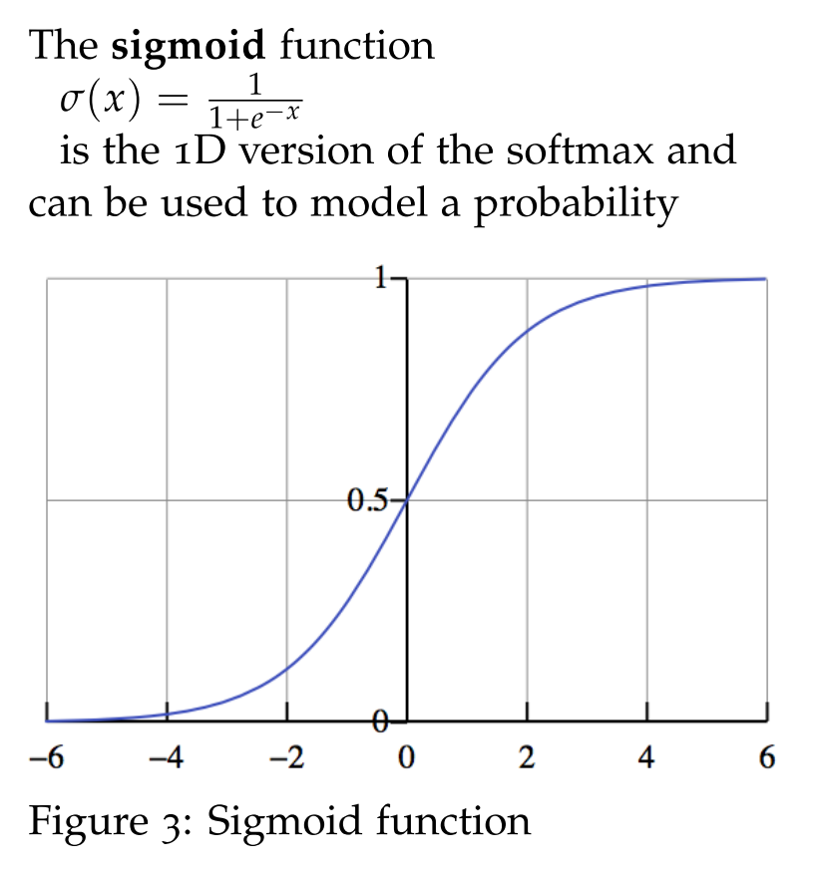

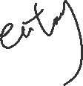
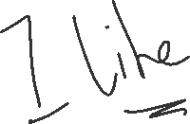
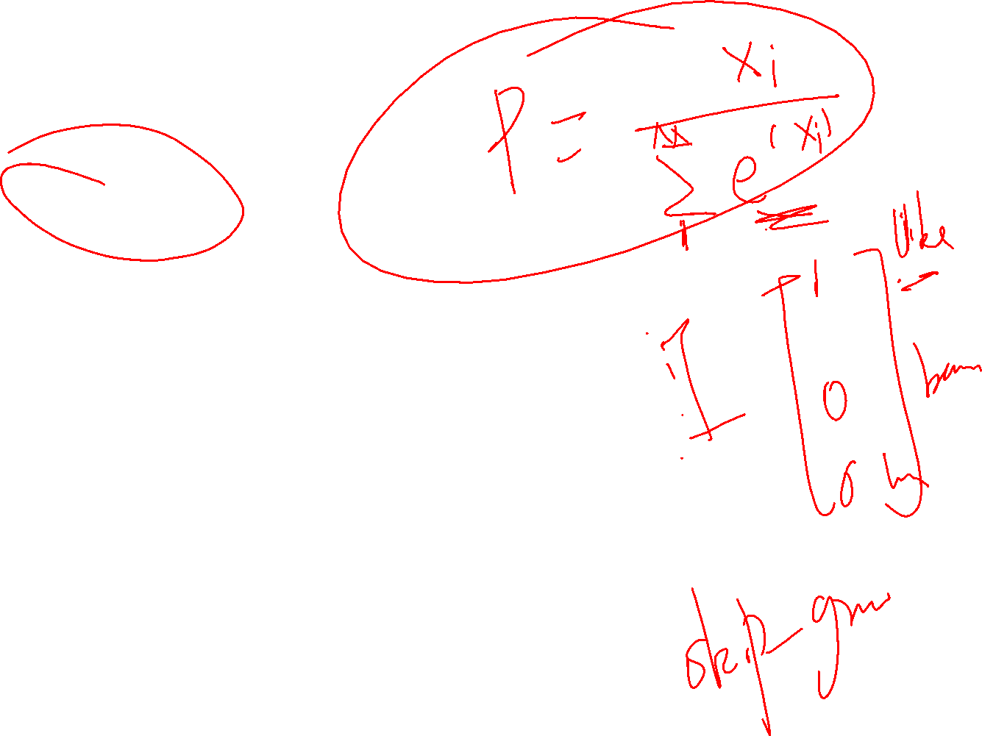
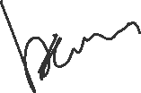
negative sampling

Slide 19
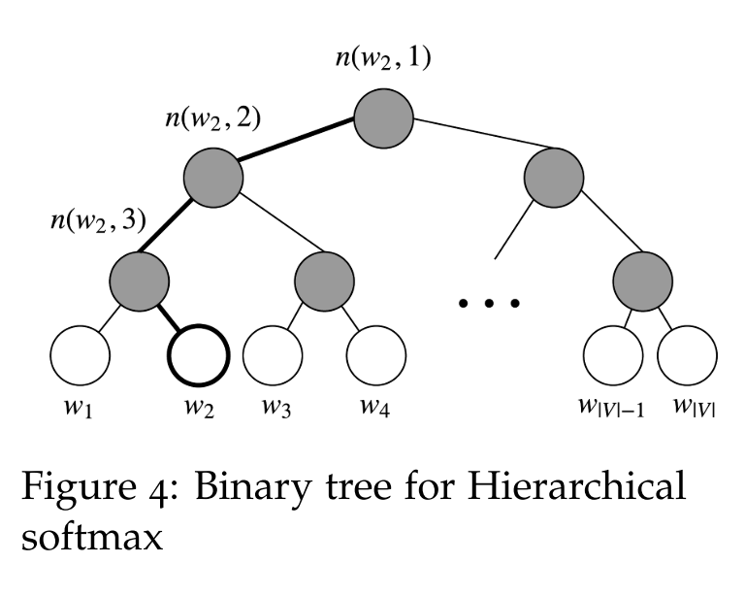
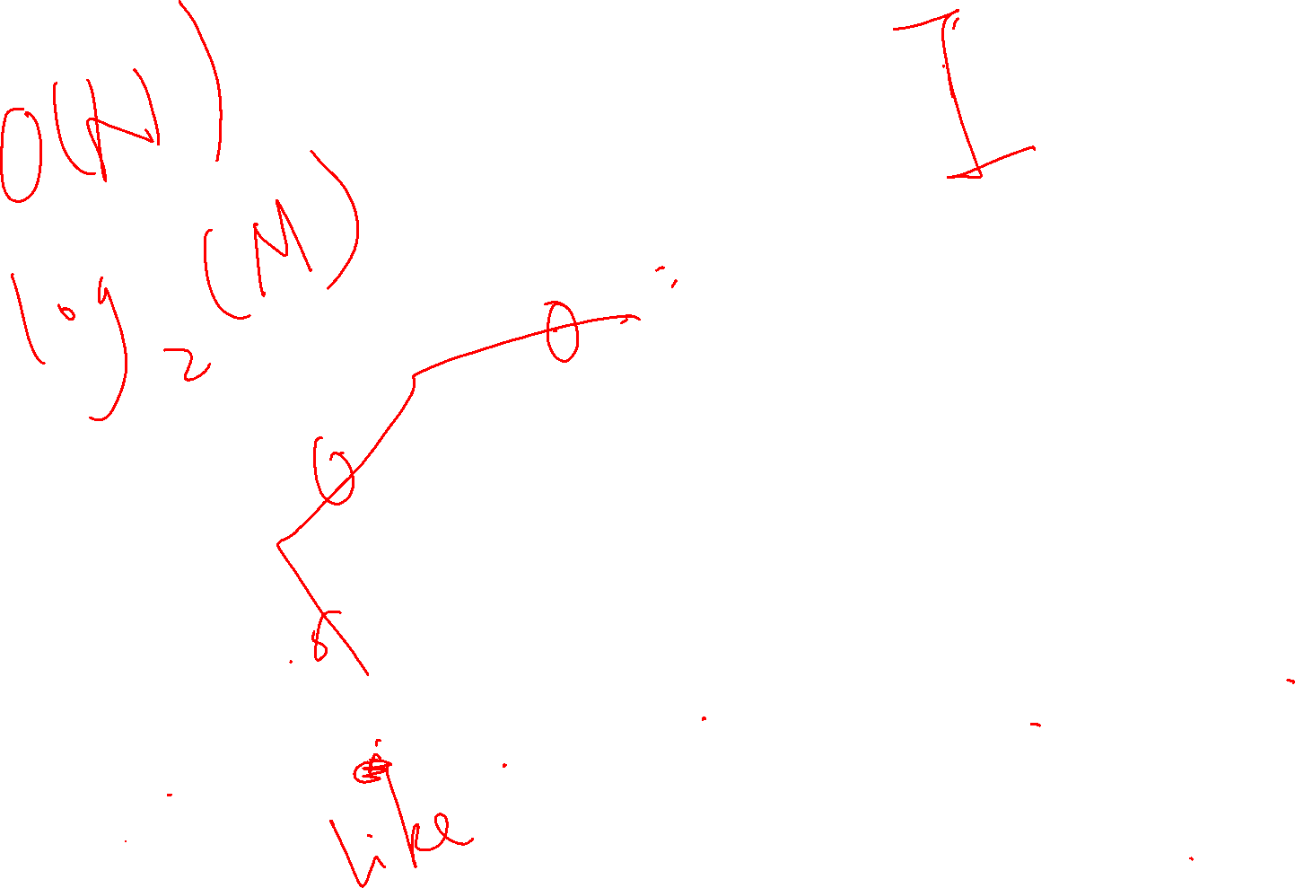
hierarchical softmax

